Slide 1
Heat:

Slide 2
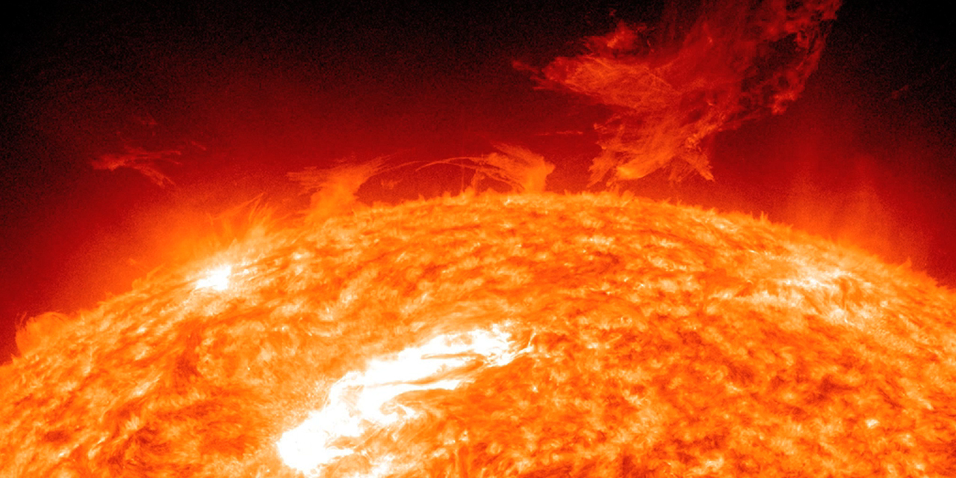
Heat:
Matter is composed of tiny particles that are always moving.

Slide 3
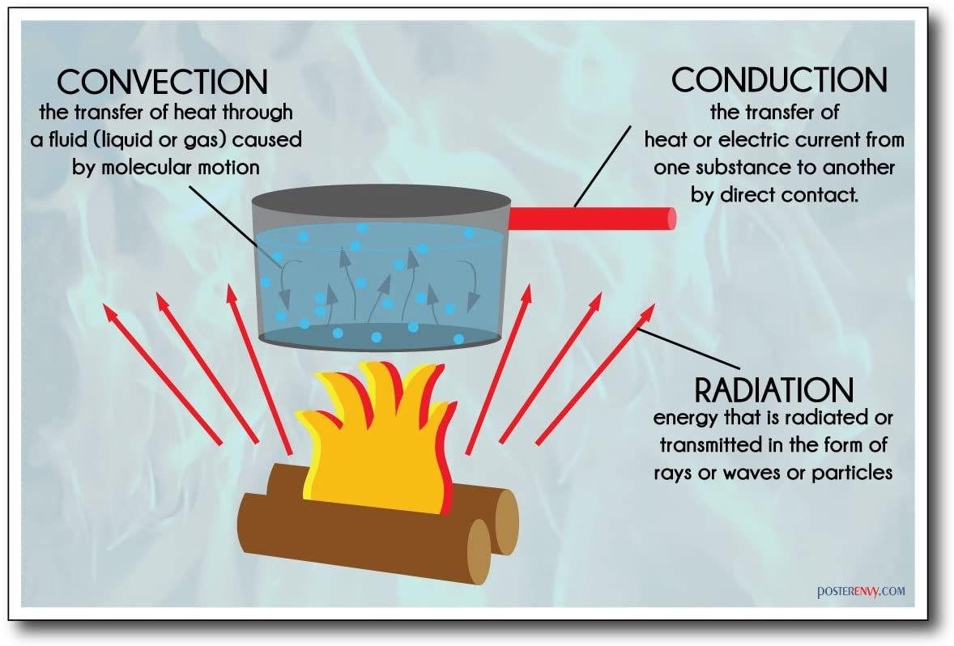
Heat transfer:
Convection: When liquid and gases heat up.
Conduction: When heat is transferred by conduction.
Radiation: When heat sources such as gas coker.

Slide 4
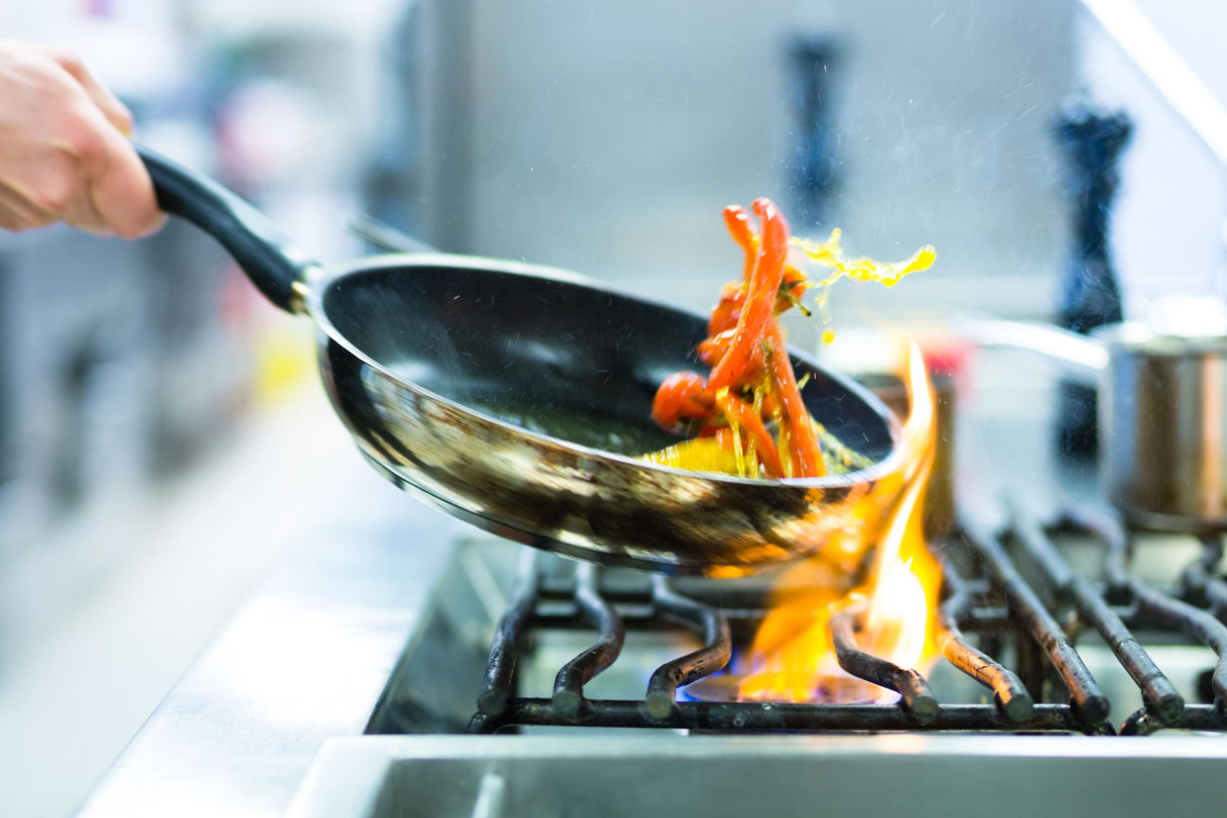
Thermal conductors and insulators:
Some materials are good thermal conductors because they transfer heat every effectively.

Slide 5
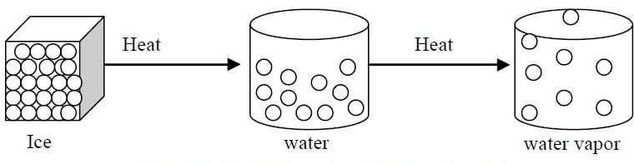
Effects of thermal energy:
Expansion: When we heat subtances.
Melting: Solids melt and became liquid.
Evaporation: Liquid evaporate and become gases.

