Slide 1
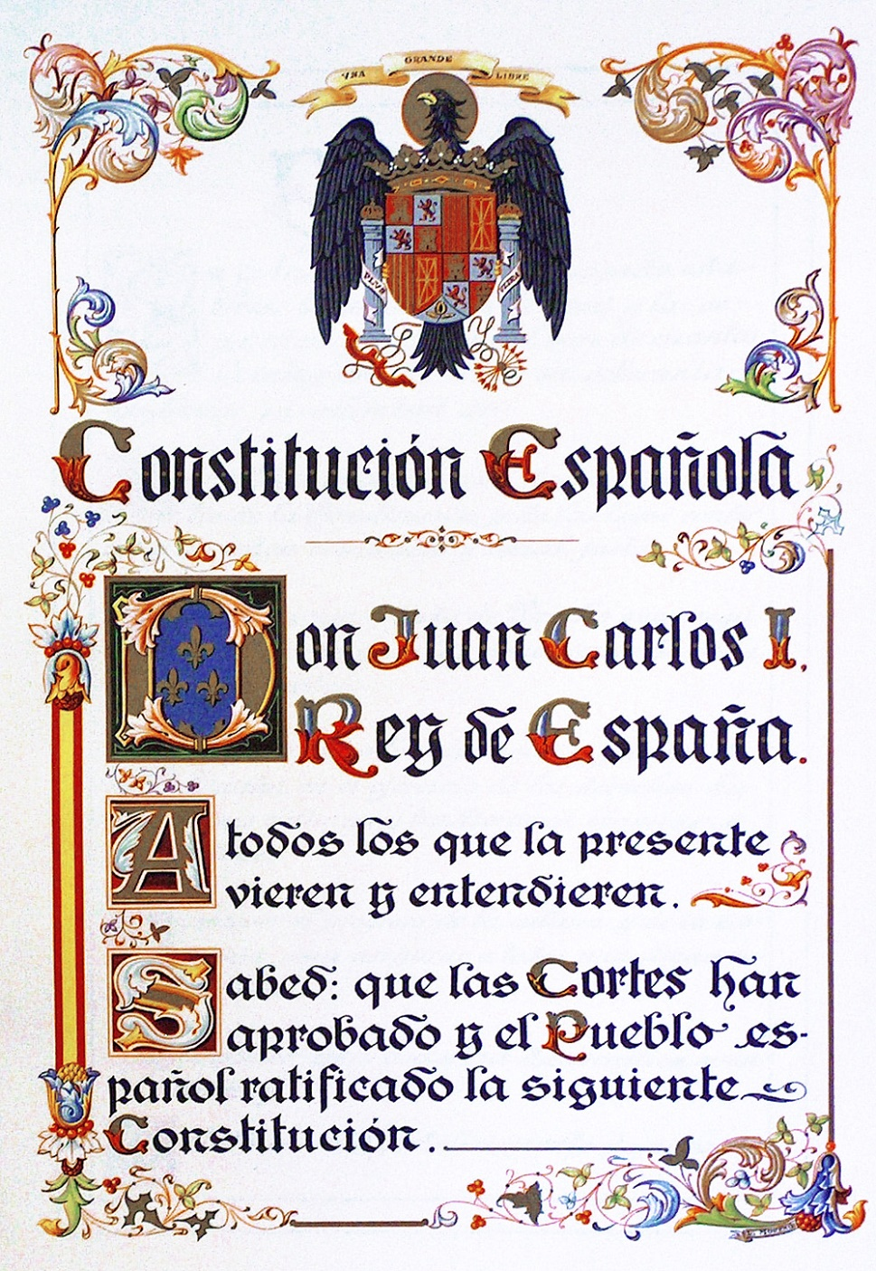
The
CONSTITUTION of
1978

Slide 2
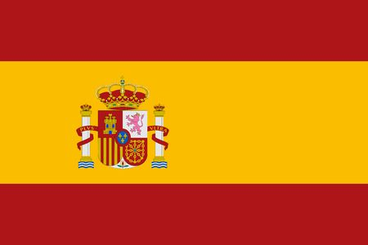
Constitution:
The constitution was written by seven people of political parties.
Parlamient approved-Referendum 6 Dec 1978-Citizens accepted.
Constitution 1978 Democracy in Spain.
Freedom, justice and equality.
The Constitution defines Spain as a:
democratic state
territorially decentralised state
parliamentary monarchy
National flag:
There are two red staits and one
yellow that is that is double than reds.
Lenguages:
National official lenguage:Spanish
Lenguages on Spain:Gallego, Euskera, Catalan…

Slide 3

Rights and responsabilities:
Rights: something a person is allowed to do.
Examples:acess healthcare and education.
Responsability: obligation to do something.
Examples:pay taxis and respect the law.

Slide 4
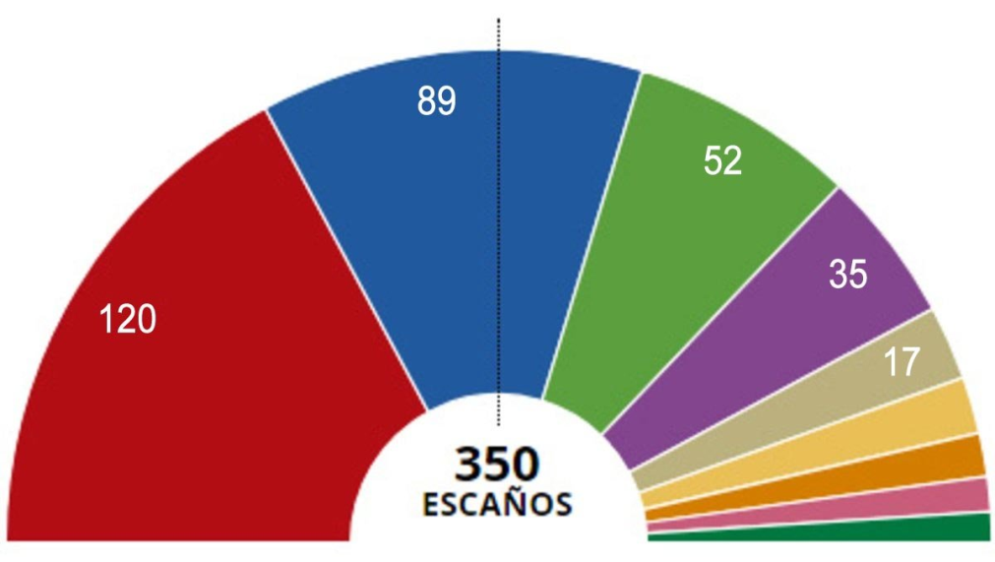
Elections:
Citizens vote to help form national goverment.
All Spanish citizens aged 18 and older have the right to vote.
There are general, autonomous and municipal elections.
Political parties campingbefore elections to exaplain how they want to improve society.
People vote by secret ballot.
The party with more votes wins the election.

Slide 5
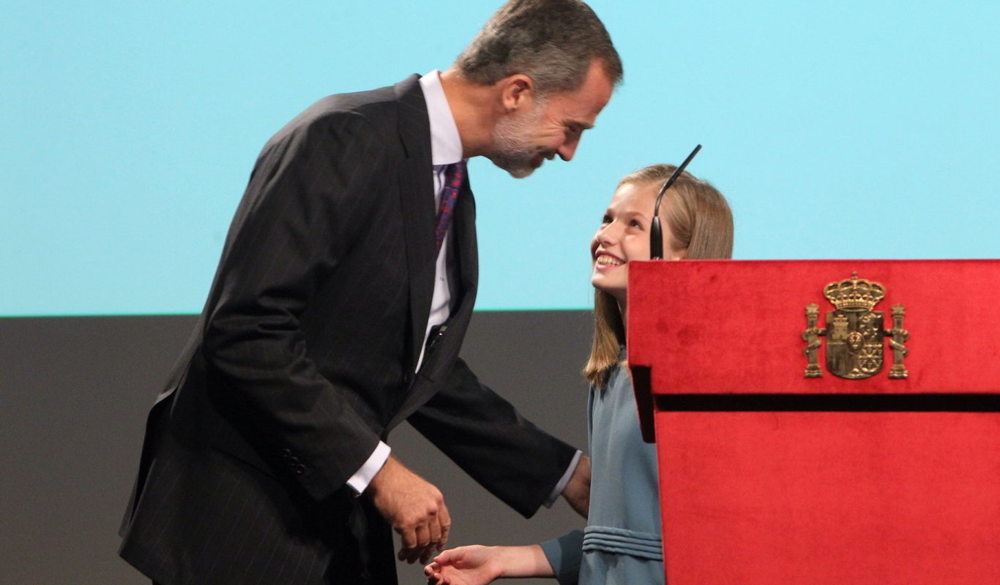
The Spanish monarchy:
Spain is a parliament monarch, with means the King or Queen is the Head of Statue.
King Felipe VI not make laws but he represent Spain and is also commander in chief of the Spanish Armed Forces.
The Constitution permits a female to the throne if she has no brothers.
The Princess of Asturias, Leonor, has no brothers and their to the throne from her father.

