Slide 1
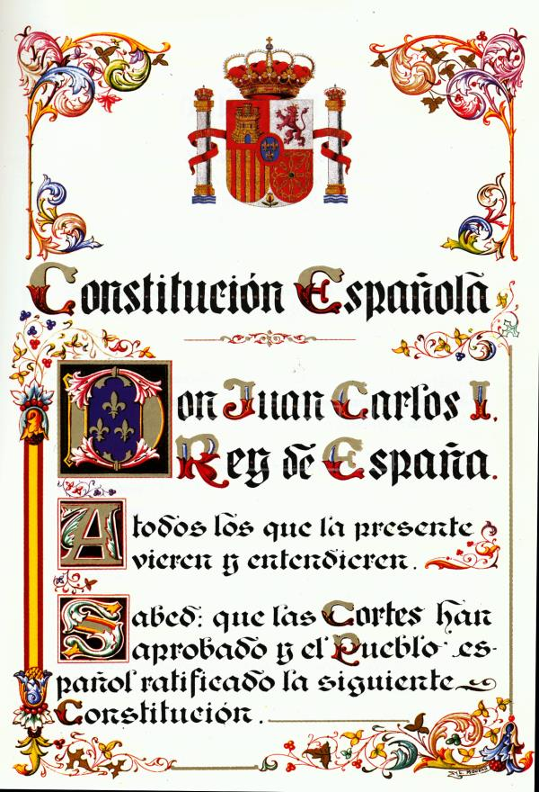
THE
CONSTITUTION
OF
1978
By:
Sara
Langreo

Slide 2
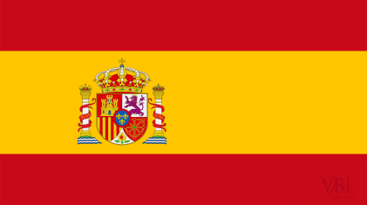
p
The Constitution
The constitution was made up by seven people fron different political parties.
The contitution was aprobe the 6 Dicembre 1978
The Constitution’s values are Freedom, Justice and Equality.
The Constitution defines Spain as a:
Democratic State ,Trerritorially descentralised state , Parlamentary Monarchy
The state’s official language is Spanish but the contitution recognises other
Lenguages.

Slide 3
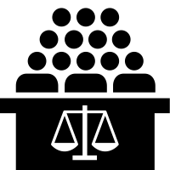
9
Rights and Responsabilities
The right is something a person is allowed to do; such as education and a health care
The responsability is an obligation to do something; such as pay taxes and respect the law

Slide 4
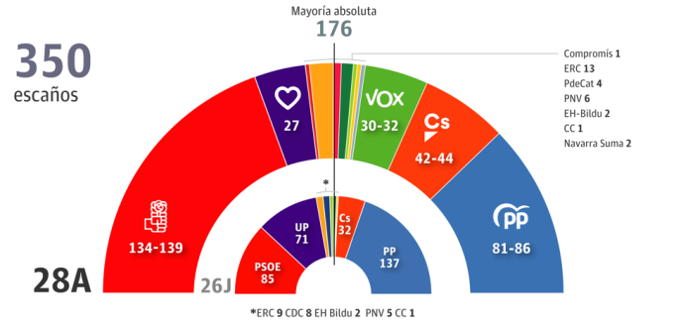
lo
Elections
They are general, autonomous community and municipal elections every 4 years.
Political parties campaign before an election explain how they want to improve society.
People vote by secret ballot. Every vote is anonymous.
The party with the most votes wins.

Slide 5
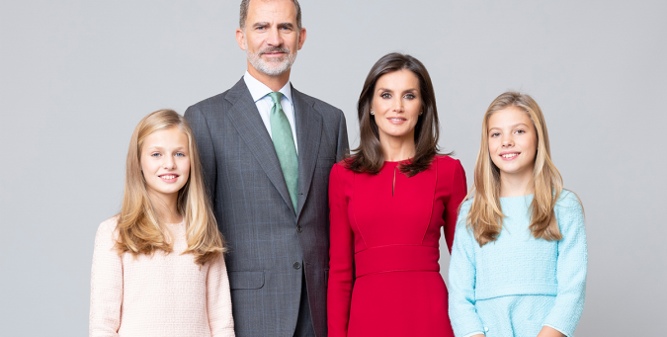
l
The Spanish Monarchy
Spain is parlamentary monarchy, which means the king or queen is head of the state, but parlamentary makes and approves laws.
The king does not make any law. He represents Spain in International relations.
The Princess of Asturias, Leonor, has no brothers and is the heir of the throne from her father.

Slide 6
The end

