Slide 1

Social Science
14/4/2020
Carmen Asenjo Godino 6º A

Slide 2

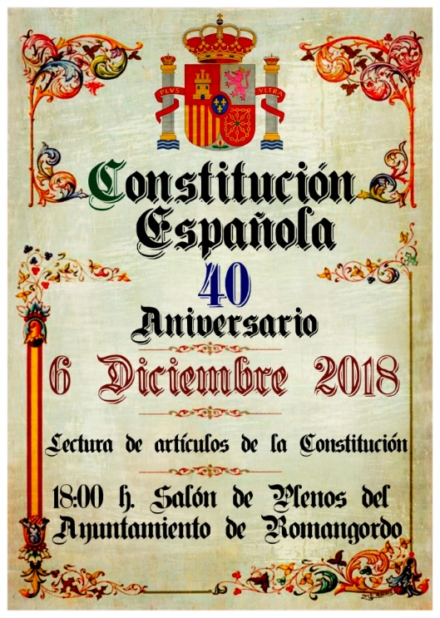
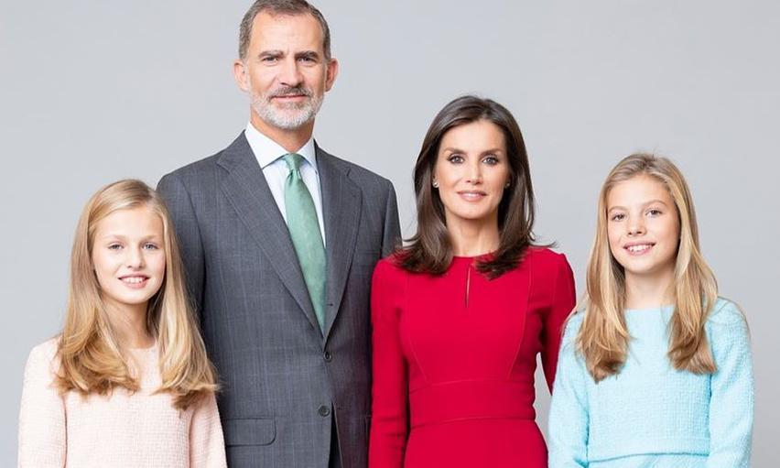
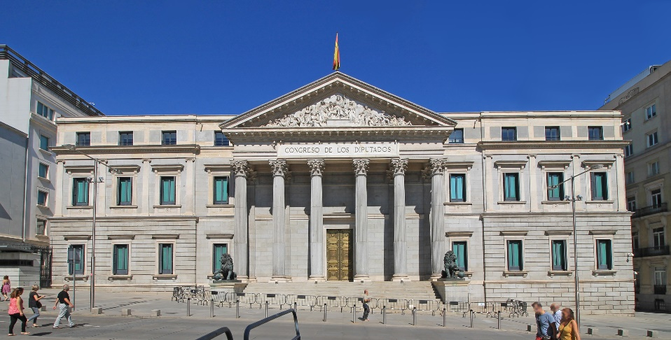
UNIT: 3
14/4/2020
Spanish Political Organisation

Slide 3


Let´s begin
14/4/2020
1. Can you name the current Prime Minister of Spain? When did he or she become Prime Minister?
- The Prime Minister of Spain is called Pedro Sánchez.
- He become Prime Minister in June 2018.
2. The Prime Minister chooses Ministers to help from the government. List any ministerial departments you know.
-Minister of education -Minister of work -Minister of health
3. The 1978 Constitution states many rights in Spain. Discuss the different rights you can see in the two photos. Why do you think these rights are in the Constitution ?
-In the big photo is education and in the small photo is health
-I think that this rights are in the Constitution because with out education, you will not have a work and if you don´t have work and money you can´t live; and with out health you can have problems and you can die.
4. Who can vote in Spain? Is voting obligatory?
-In Spain, only people over eighteen can vote.
-In Spain vote is not obligatory.
In Spain vote is a right and an obligation

Slide 4
Reflect
14/4/2020
1. In the previous unit, you learnt there was a new Constitution in 1978. Do research to find the answers to the following questions.
a) Who wrote the Constitution?
Gabriel Cisneros Laborda and Miguel Herrero wrote the Constitution.
And
They belong to PP.
Gabriel Cisneros (UCD), Miguel Herrero y Rodríguez de Miñón (UCD), Manuel Fraga (AP), Gregorio Peces-Barba (PSOE), Miguel Roca (Minoría Catalana) and Jordi Solé Tura (PSUC)
b) Which Political parties did they belong to?
c) What does Section 14 of the Constitution say? Says that the Spanish are equal before the law.
d) When did the Spanish people vote on the Constitution? Every four years.
6 December 1978
(27 December)
e) When did King Juan Carlos I sing the Constitution? In 1978.
2. Do you think a Constitution is a good idea? Give some reasons .
I think that a Constitution is a good idea because it give rights that we need and because if we don´t have that rights we would be unprotected.
3. Read the sentences below. Decide if they are true or false.
All citizens over 18 can vote.
a) In Spain, only men can vote when they are 18. False
b) There are general elections every four years. True
c) The King chooses the goverment in Spain. False
The people choose the government.
d) The Constitution of 1978 states that Spain is a decomcrazy. True

Slide 5
4. Copy and complete the sentences.
14/4/2020
a) Spain is a parliamentary monarchy.
b) The Prime Minister is the Head of Goverment.
c) The king is the Head of State.
(child)
Monarch
d) The Spanish monarchy is hereditary. This means the son/ daughter of the King or Queen is heir to the throne.
5. After the 1978 Costitution, women gained many rights that they did not have during the dictatorship. In, do research on the rights of women in Spain. Use the words in the box to help you think and research.
a) What right did the women have before 1978?
They didn´t have rights because they were depending of men.
b) What rights do women have today?
They have freedom to choose clothing, they can have employement, they can vote, they can divorce, they can have a bank account, they can be on goverment positions and be on armed forces.
c) What rights do you think people still fight for today?
Fighting for gender equality and against gender violence.

Slide 6

Pag 46-47
16/4/2020
The Costitution of 1978
1. What are the three oficial languages in Spain? How many of them do you speak?
The three oficial languages in Spain are Spanish Catan and Basque .
I only speak Spanish.
Galician and Valencian
2. These words appear in the Constitution . What do they mean?
- Liberty: Liberty is that people have freedom to say and do what they want.
- Justice: Justice is that for example when someone do something bad then they would have they will have a punishment.
- Equality: Equality is to value everyone the same.
Use of fair laws
Pag 47
In Spain, the government is formed when citizens over 18 vote in elections. The party with the most votes wins the elections. The people of the nation choose the party that will govern.
4. How is a democratic goverment formed in Spain?
The Constitution define the democratic goverment and people vote every four years.
5. How does the role of Parliament differ from the role of the Spanish Monarch?
Parliament is responsible for making and approving laws whereas the Spanish monarch are the Head of State.

Slide 7
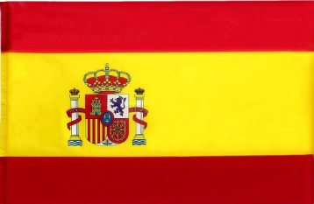
The Constitution was written by seven people from different Political parties. It was accepted on 6 December 1978. The Constitution is the foundation of democracy.
16/4/2020
The Constitution of 1978
The Constitution´s values are freedom, justice and equality. It also covers the rights and responsibilities of Spanish citizies.
The Constitution defines Spain as a:
· democratic state
· territorially decentralished state
· parliamentary monarchy
The Constitution also defines the national flag that has two red stripes and one yellow.
The oficial language of Spain is Spanish but the Constitution also recognise other languages of some autonomus comunities.
The Constitution says that all citizens are equal and protecs people from discrimination.
Rights and responsibilities
All Spanish citizies have rights and responsabilities
- A right is something that a person is allowed to do. - A responsability is an obligation to do something.
Elections
In a democracy, citizens vote to help national and local goverments.
Only Spanish citizens aged 18 and older have the right to vote.
· The elections are every four years.
· Before have elections politics campaingn.
· People vote by secret ballot.
· The Paty with the most votes win.
The Spanish monarchy
Spain is a parliamentary monachy, so the King or the queen is the Head of State.
Parliament makes and approves laws.
King Felipe VI doesn´t make any laws, he represents Spain in international relations. He´s also commander in chief of the Spanish Armed Forces.
The first male firstborn child is the heir to the throne, but the Contitution also permits a female heir if she don´t have any brothers so the heir to throne is the Princess of Asturias, Leonor.

Slide 8
Pag 48
20/4/2020
DIVISION OF POWER
LEGISLATIVE
POWER
EXECUTIVE
POWER
JUDICIAL
POWER
Government
Congress
Senate
Supreme Court
Constitutional Court
Prime Minister
deputies
senators
Ministers
judges and magistrates

Slide 9
Pag 48
Names of Ministers and their Ministers
20/4/2020
- Carmen Calvo Justice
- Pablo Iglesias Equality
- Nadia Calviño Economy and business
- Teresa Ribera Ecological Transition and the Demographic Challenge
- María Jesús Montero Estate
- Isabel Celaá Education
- Pedro Duque Science
- José Luis Ábalos Transport, movility and urban agenda.
- Fernando Grande-Marlaska Inside
- Reyes Maroto Industry
- Arancha González Laya Foreing
- Margarita Robles Defense
- José Luis Escrivá Social Security, Inclusion and Migrations
- Luis Planas Agriculture, fishing and food
- Salvador Illa Health
- Alberto Garzón Consumption
- Irene Montero Equality
- Yolanda Díaz Work
- Manuel Castells Universities
- Carolina Darias territorial policy
José Manuel Rodrigez Uribes
Alberto Garzón

Slide 10
Pag 52
22/4/2020
REVIEW
1. Copy and complete the table with the word in the box.
Judicial power
Legislative power
Executive power
Parliament : Senate and Congress of Deputies.
Prime Minister and the Ministers
Judges and magistrates
They ensure that laws are obeyed.
They develop and vote on laws.
They make decisions about domestic and foreing policity.
3. Put these steps of Spain´s national elections in correct order.
4
a) The members of Congress choose the Prime Minister.
b) Political parties campaing.
1
e) The party with the most votes wins.
3
d) Citizens vote by secrect ballot.
2
e) The Prime Minister chooses Miniters to help run the goverment.
5

Slide 11
Pag 52
22/4/2020
4. Look at Spain´s coat of arms and answer the following question. Do research to find the you do not know.
a) The coat of arm has the Spanish national motto, Plus Ultra. What does this mean in Latin?
It means further beyond.
b) Which Spanish monarch had this same motto?
Carlos I
Charles I
c) The ribonn on coat of arms is wrapped around two pillars. What are they?
Pillars of Hercules.
d) What is the relationship between the motto and the two pillars?
That both are part of the coat of arms.
The Pillars of Hercules was the high land in the Strait of Gibraltar (one in Gibraltar and the other possibly in Morocco). They were a symbol that marked the end of the Ancient Greek world. The Pillars of Hercules and the phrase “further beyond” refer to the exploration of the Americas.

