Slide 1

15/4/2020
NATURAL SCIENCE
Carmen Asenjo Godino 6º A

Slide 2
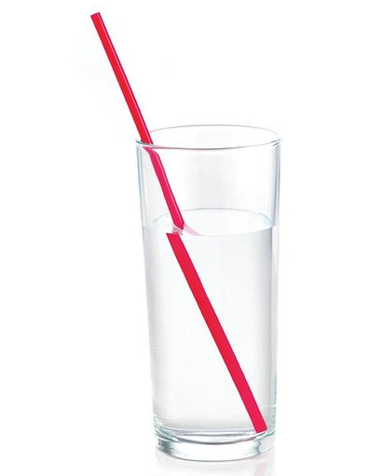
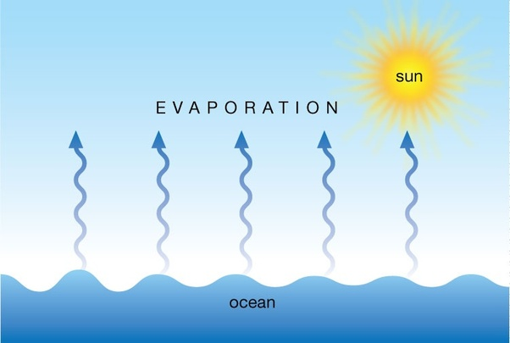
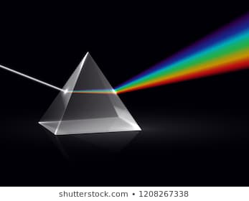

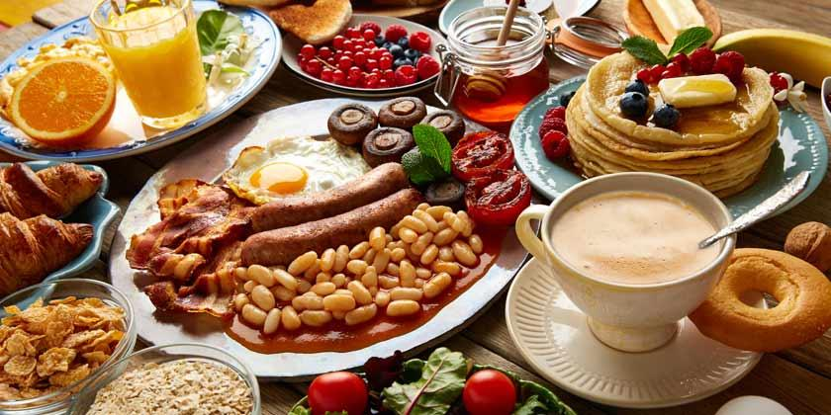
UNIT: 5
15/4/2020
Matter and energy

Slide 3


Let´s begin
15/4/2020
Pag 77
1. Look at te photos. What forms of energy can you see? What are they used for?
-I can see solid, liquid and gas.
-Solid is used for the tres, the snow, the camping tent…etc
-Liquid is used for the water of the river and for the tea.
- Gas is used for tea that is very hot and is evaporating a bit.
Potential energy: energy stored in the lake and in the wood burning in the campfire; light energy: the lamp inside the tent gives light; thermal energy; the campfire and the hot mug provide heat.
2. What forms of water can you see in the photos? What other forms of water can we find in nature?
-I can see two forms of water in the big photo that are in the river that is liquid and in the snow that is solid.
-In nature we can also find other form of water that is when water evaporates that it would be gas.
And steam
There is liquid water, snow and steam. In nature, we also find water as ice, in clouds, as fog, as hail or frozen rain, as icicles, etc.
3. Discuss these questions.
a) If we heat snow, what happens to it?
e) What is a mixtures homogeneus? Are all mixtures homogeneus?
-A mixtures homogeneus is when you mix the same things like if you mix chocolate and chocolate it will be a mixture homogeneus.
-All mixtures are not homogeneus they can also be heterogeneous.
If we heat snow it will melt and become water.
b) What happens when we boil liquids?
If we boil liquids they will evaporate.
a mixture consists of one or more substances
c) What do we get when we burn wood?
When we burn wood we get fire.
a chemical reaction with oxygen
d) What other types of fuel do we burn?
We also burn coal and oil.

Slide 4
Pag 77
15/4/2020
4. What types of energy do we use in everyday life? Why are these types of energy useful?
-We use the three types of energy, liquid (to drink and wash), solid (are all the things around us except liquid and gas) and gas (we use it to breath).
We use mechanical energy to make objects work. We use thermal energy to heap up things. We use electrical energy to heat up things. We use electrical energy to provide power to various devices.
-These types of energy are useful because we need them to live.
5. What can happen if we don´t save energy? How can you save energy at home and at school? Make five rules for saving energy and share them with the class and your family.
- If we don´t save energy we can have problems that affect to our health.
THINGS WE CAN DO TO SAVE ENERGY:
- We can remplace your light bulbs.
- We can use less heat water.
- We can turn off the lights when we are not there.
- We can shut off computers.
- We can use natural light and heat.

Slide 5
Pag 80
15/4/2020
SEPARATING MIXTURES
1. What is the difference between heterogeneous and homogeneous mixtures?
The difference is that homogeneous mixture is a mixture that we can´t see what is mixed because it´s completly mixed and in a heterogeneous mixture you can see what elements are because they are separated.
2. How can we separate these mixtures?
a) sugar and water
distillation
We can separate if we take the water and we evaporate then we can take the sugar.
b) Petrol and water
We can separate using a separating funnel and we wait and they would separate.
decantation
c) Leaves and water
We can separate if we put the leave in a wait till the water goes out.
filtration
d) Mud and water
decantation
We can separate using a separating funnel and the water will fall down

Slide 6
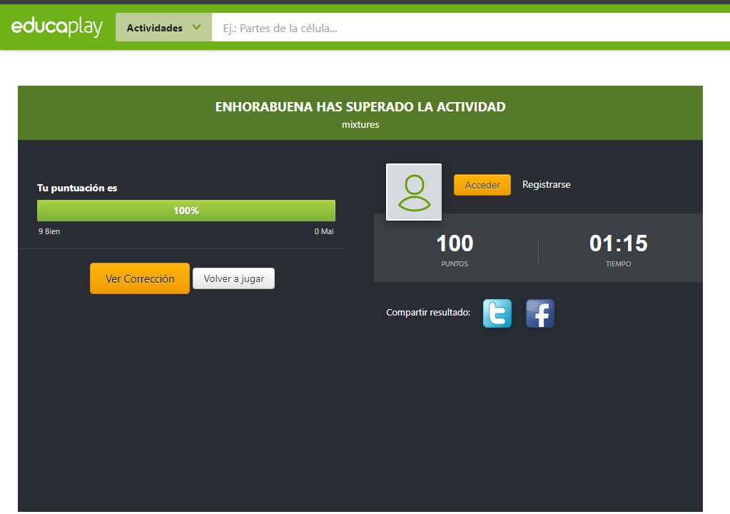
15/4/2020
This is my puntuation in the game of homogeneous/heterogeneous

Slide 7
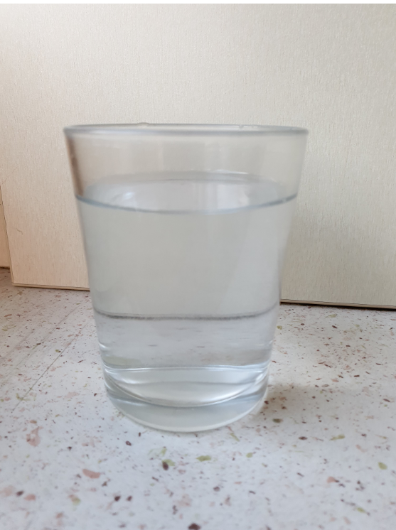
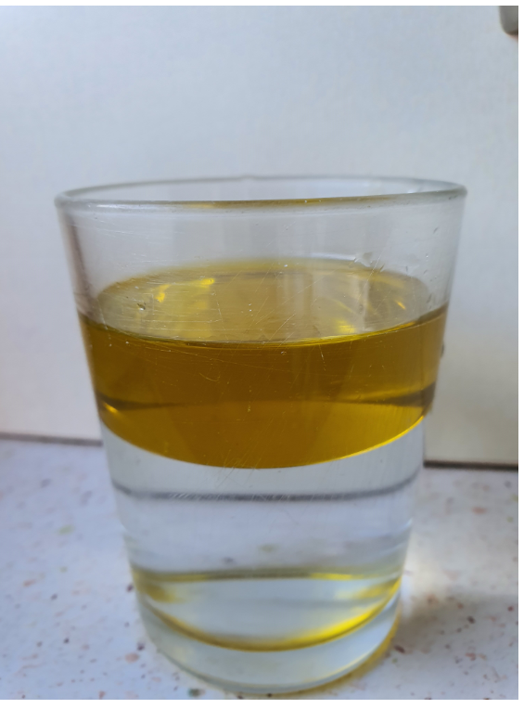
MY PHOTOS
15/4/2020
Homogeneous
Heterogeneous
Salt and water
Oil and water

Slide 8
Pag 81
16/4/2020
3. Discuss the questions.
a) What can magnets attract?
(magnetic metal)
Magnets can attract metal.
b) Why does sand sink in water?
Sand sinks in water because it is more dense.
c) How does a filter function?
A filter functions by stopping small particles from liquids and gases while letting the liquid or gas pass through.
An air filter functions by separing dust and pollen.
d) How can we separate oil and water?
We can use decantation into another container to separate oil and water.

Slide 9
Physical changes
21/4/2020
Changes of state
Changes in shape, position and texture
Mass, volume, density
Types of Physical changes
Matter exist in solid, liquid and gas. It can change from from liquid water to ice and from water to steam (a gas)
·Mass:
The amount of Matter that an object contains.
·Volume:
The amount of physical space that an object occupies.
·Density:
The amount of Matter that occupies a space.
Matter can change shape, position and texture. For example: from a piece of flat aluminium to a ball of aluminium
Reversible change
irreversible change
Are changes that are temporary and can be reversed.
Are permanent changes that cannot be reversed.
Solid ice: It has a stable shape and volume.
Liquid water: It has a stable volume, but change shape.
Gaseous steam: It doesn´t have a stable shape or volume.
mass
density=
volume

Slide 10
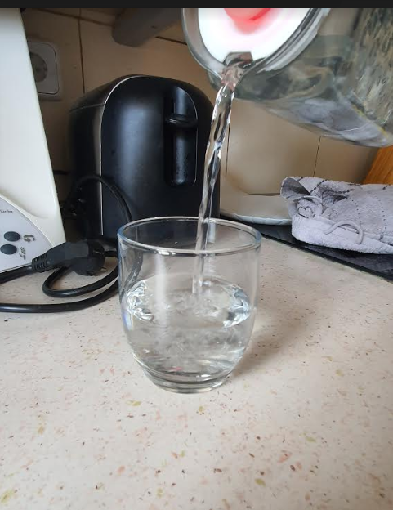
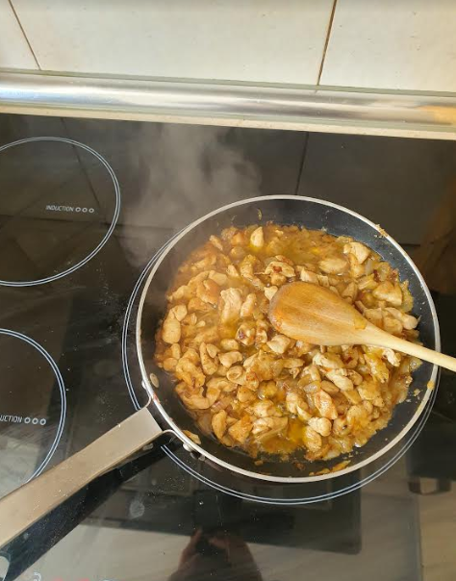
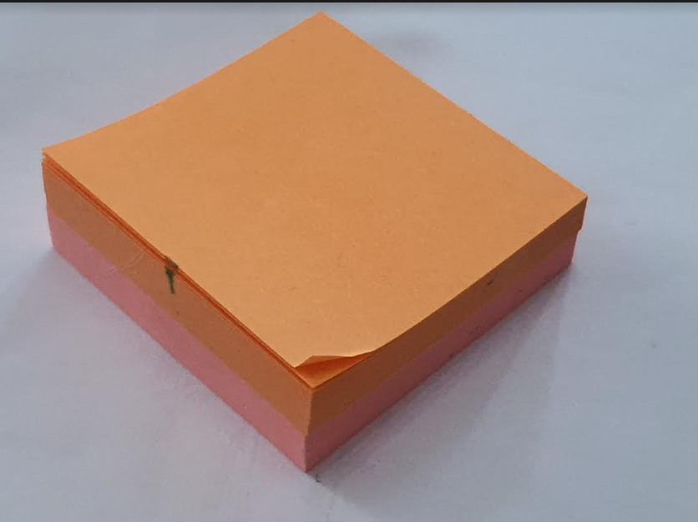
My photos 1
21/4/2020
Liquid: water
Solid: posits
Gas

Slide 11
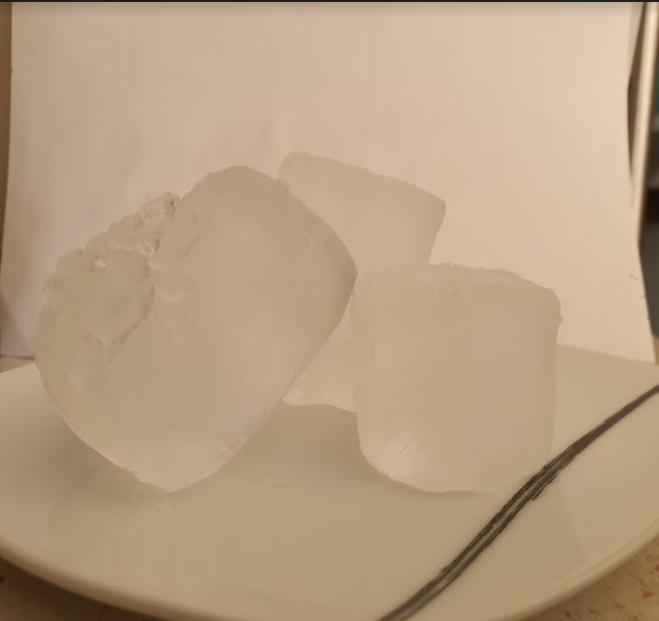
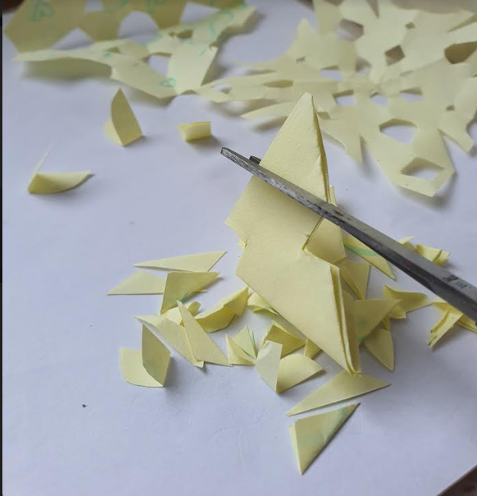
21/4/2020
My photos 2
Reversible change: ice
Irreversible change: Cut papers

