Slide 1
ENGLISH
14/4/2020
Carmen Asenjo Godino 6º A

Slide 2
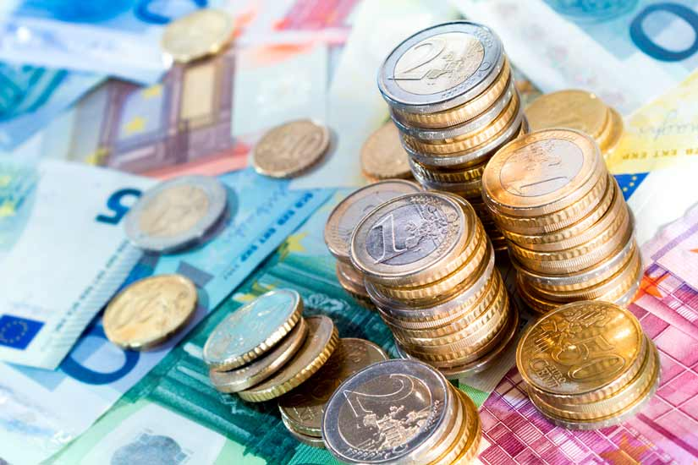
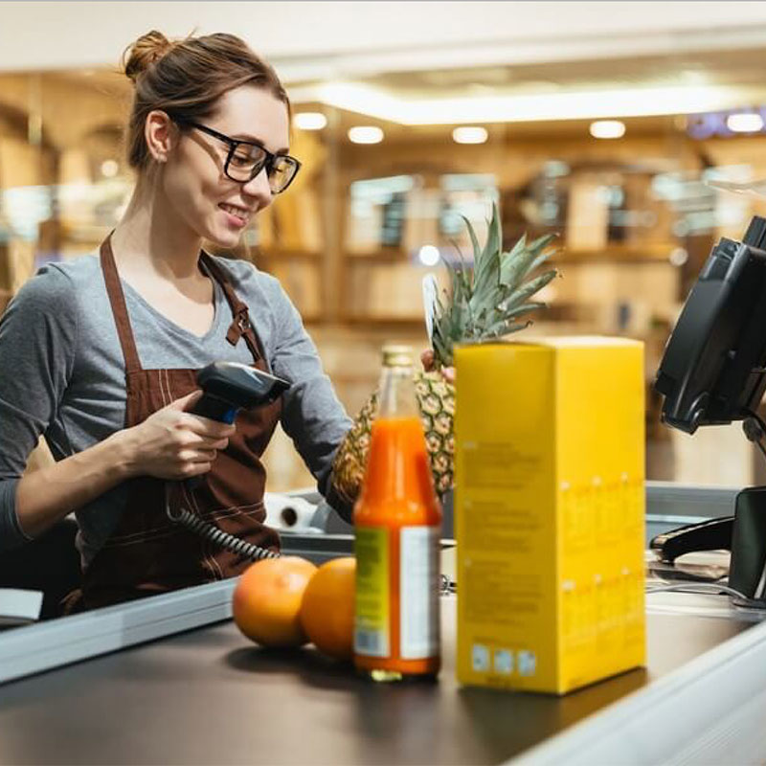
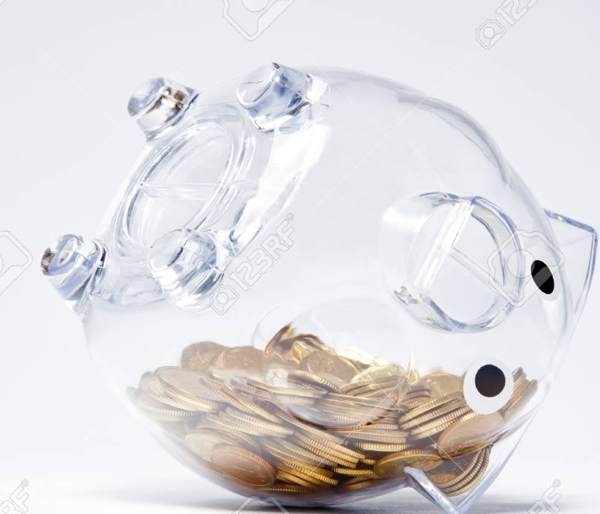
BUYING AND SELLING
14/4/2020

Slide 3
Vocabulary
14/4/2020
1. Purse
2. Credit card
3. Coins
4. Banknotes
5. Price tag
6. Receipt
7. Costumer
8. Cashier
9. Till
10. Spend money
11. Save money
12. Money box

Slide 4

14/4/2020
1. Look at Kelvin´s photos. Answer the questions.
1. What can we see in the photos?
Different forms for paying.
2. Where do you and your family go shopping?
In a supermarket.
3. Do you or your family buy things online? Do you prefer shooping online or in a shop?
Somethings but not grocery – I prefer online
2. Look and mach whith photos 1-12.
1- Purse
2- Credit card
3- Coins
4- Banknotes
5- Price tag
6- Receipt
7- Costumer
8- Cashier
9- Till
10- Spend money
11- Save money
12- Money box

Slide 5

14/4/2020
5. Read the rest of Kelvin´s message. Would you like to take part in sale like to take part in sale like this ? What would you sell?
-Yes I would take part in sale like this because I would things that I don´t use and earn a lot of money.
-I would sell things that I don´t use like clothes that I'm not worth it anymore are games that I don´t play.
Pag 74
15/4/2020
Lesson 2 gramar
2. Read and say true or false. Correct the false sentences.
1. The prices at the sale are higher than in the shops.
False
cheaper
2. They aren´t going to have the sale in the school hall because it´s too small.
True
3. The teddies are for children younger than Kelvin.
True
4. Kelvin wants the sale to be as fair as posible.
True

Slide 6

6. Look at the pictures and make sentences.
15/4/2020
2. In this picture, the plant isn´t big enough to this flower pot.
3. In this picture, the milk is too tall for the boy.
4. In this picture, the girl is older than the boy.
(The bag isn’t big enough for the plant.)
The boy isn’t tall enough to reach the milk.
(The boy isn’t as old as the girl.)
Pag 76
20/4/2020
Lesson 4 Grammar and Pronunciation
4. Read the article on page 75 and dialoge in Activity 1 again. Find more examples of the first conditional.
If something is from Fairtrade producers, it´ll have a FAIRTRADE Mark on it.
If we buy Fairtrade products, it´ll help the workers in poorer countries.

Slide 7
20/4/2020
Grammar wall
FIRST CONDITIONAL
If we buy Fairtrade products, it´ll help the workers in poor countries.
If I finish my homework early, I´ll play games on the computer.
One or both of the verbs can be in the negative:
If it doesn´t rain, we´ll play tennis.
If you don´t buy a ticket, you won´t win a prize.
What will you do if you miss the bus this afternoon

Slide 8
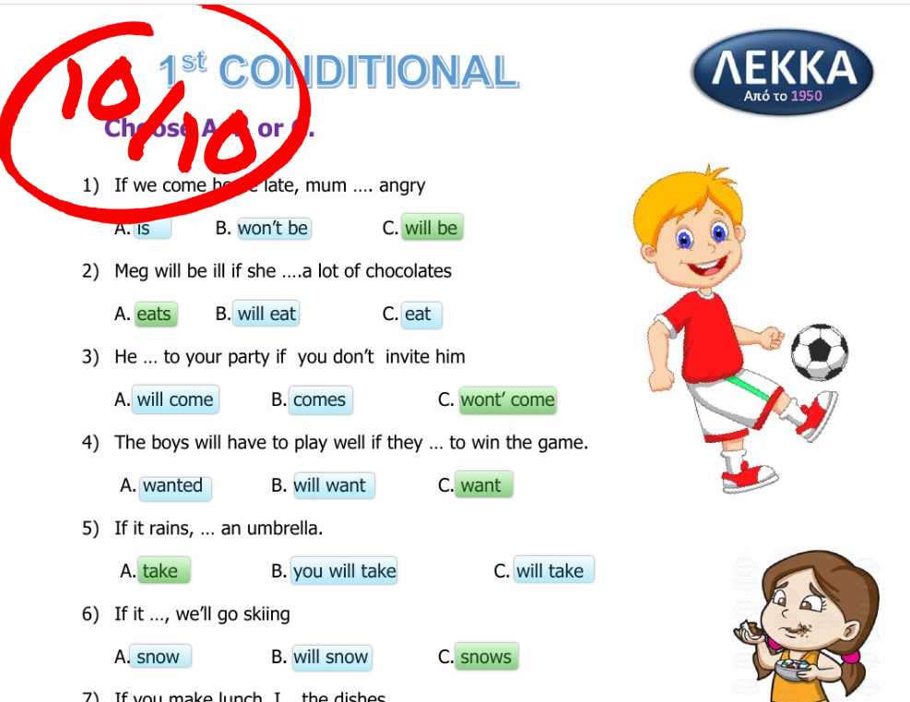
21/4/2020

Slide 9
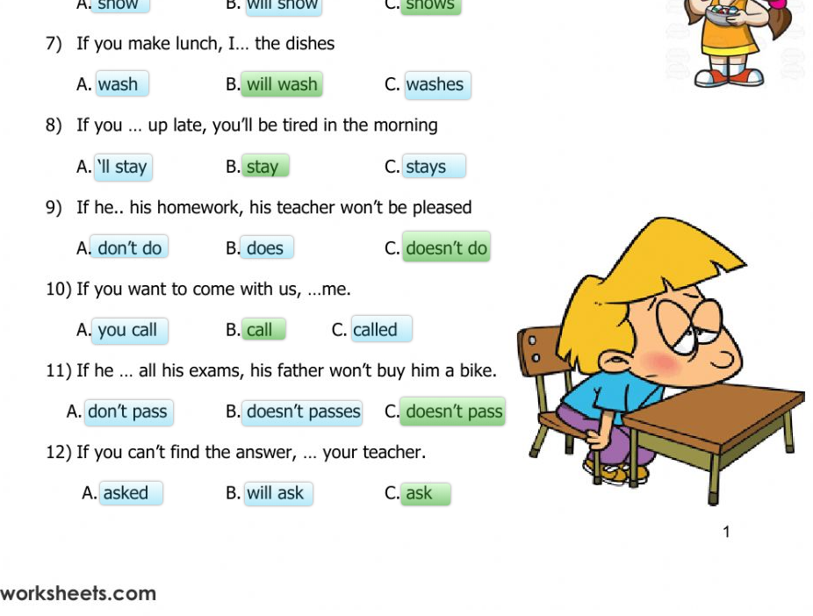
21/4/2020

Slide 10
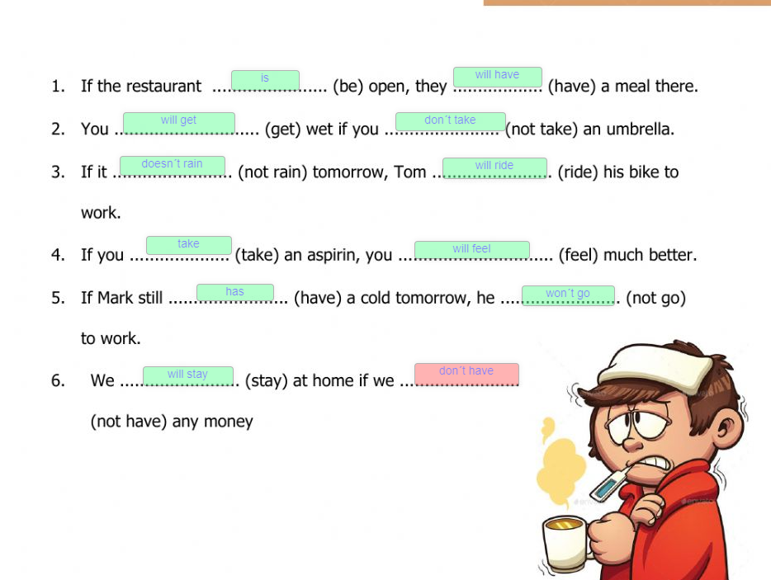
21/4/2020

Slide 11
Pag 78
22/4/2020
1. Read and discuss.
·Where have you seen adverts for these things?
I have seen these adverts in television, in the radio and in a poster.
·What do adverts try to do?
They try to do that you buy the thing that they are selling.
·When have adverts persuaded you to do something?
When I want something for christmas.
2. Look at the photos. Which would you most like to try? Read and see if you still feel the same way.
The most thing that I like to try is Swoop Stunt Kities.
3. What do you think?
Did you change your mind after reading these text?
Yes, I change my mind after reading these text.
Yes, I did
Which phrases in the adverts will help sell the items most?
-You will have fun for years! -But be quick-at this price they´ll sell quick!
-If you buy two, you´ll get a 10% discount!
Do you think everyhing in the adverts is true?
No, because somethings are only to sell.

Slide 12
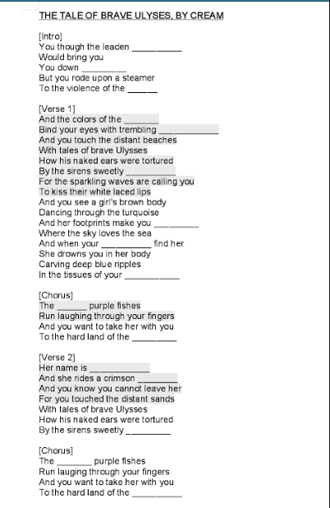
23/4/2020
winter
forever
sun
sea
mermainds
singing
follow
fingers
mind
tiny
winter
Aphrodite
shell
singing
tiny
winter

Slide 13
Gods / Goddess miths
23/4/2020
I´ve read:
- Atena - Hera - Aphrodite - Hades - Zeus
My favourite is Atenea, because usually the Gods that fight are boys and Atenea was Known as the Goddess of the war, the civilization, wisdom and strategy and she was a girl. Also beacause she was strong and very inteligent.

