Slide 1
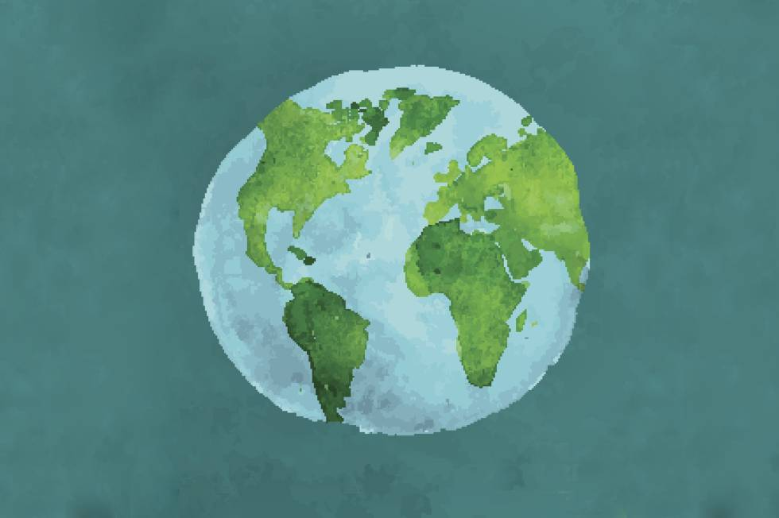
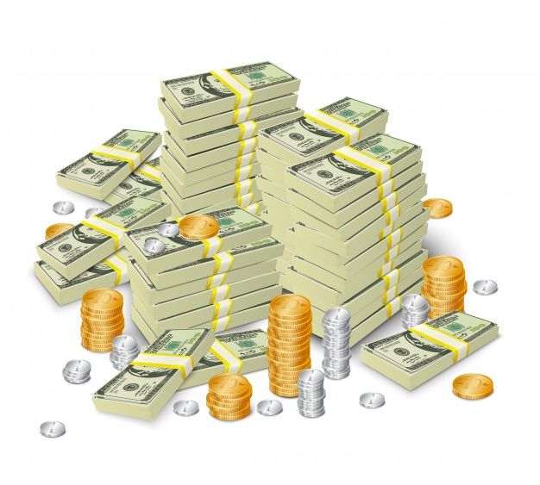


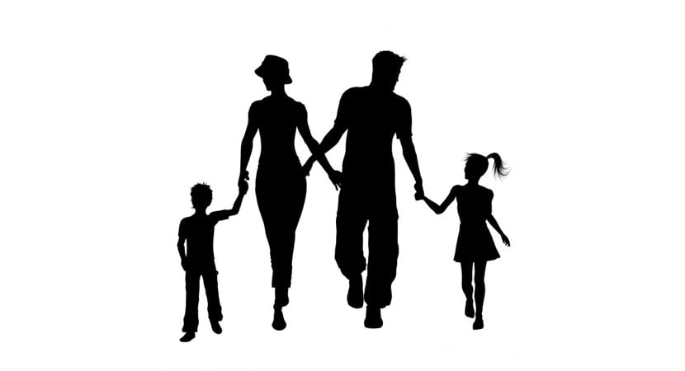
SOCIAL SCIENCE
By: Ainhoa Suárez-Llanos Barquilla

Slide 2
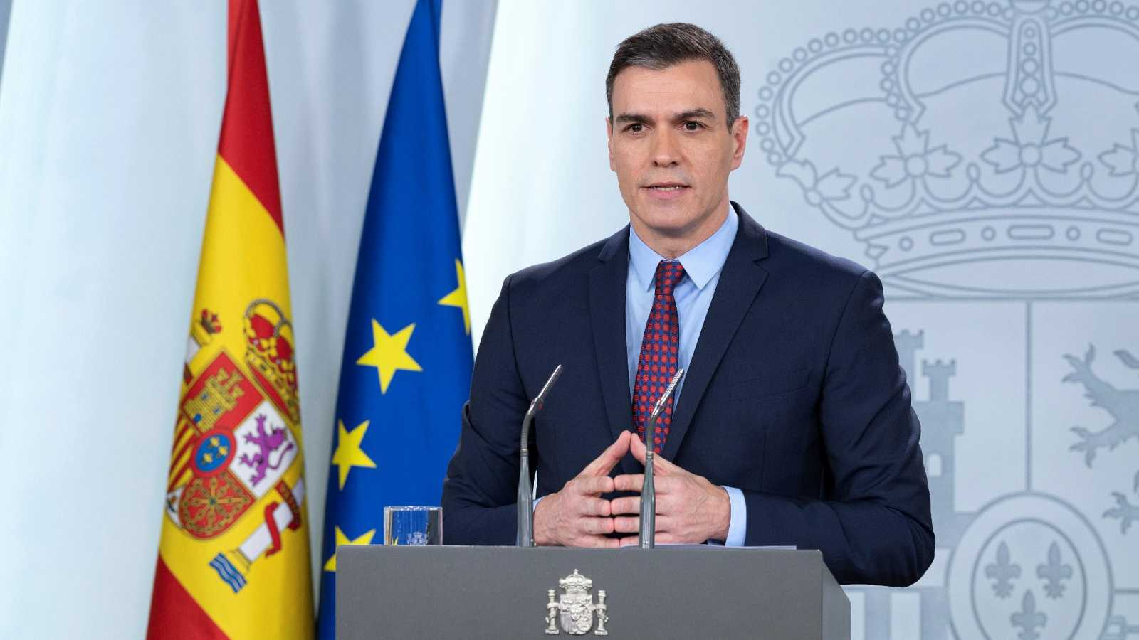
Unit 3:
Spanish Political Organisation

Slide 3
Page 43 (Let’s Begin)
1. Can you name the current Prime Minister of Spain? When did he or she become the Prime Minister?
The actuall Prime Minister in Spain is Pedro Sánchez. He became the Prime Minister on 7 January 2020.
2. The Prime Minister chooses Ministers to help form the government. List any ministerial departments you know.
Ministry of Health, Ministry of Education, Ministry of Defence and Ministry of Equality.

Slide 4
3. The 1978 Constitution states many rights in Spain. Discuss the different rights you can see in the two photos. Why do you think these rights are in the Constitution?
What I can see, is that in one photo, they show us the right of education, and in the other one they show us the right of health. I think this rights are in the constitution, because they are rights that everyone should have.
4. Who can vote in Spain? Is voting obligatory?
Anyone with or over 18 years of age, but only people with Spanish nacionality can vote. Voting isn’t obligatory, because it’s a right, not a due.

Slide 5
Page 44 (Reflect)
1. In the previous unit, you learnt there was a new Constitution in 1978. Do research to find the answers to the following questions.
a)Who wrote the constitution?
It was written by 7 people: Gabriel Cisneros, Miguel Herrero de Miñón, José Pedro Pérez-Llorca, Gregorio Peces-Barba, Jordi Solé, Manuel Fraga and Miquel Roca.
b)Which political parties did they belong to?
Gabriel Cisneros: FET y de las JONS, UCD, PL y PP | Miguel Herrero de Miñón: UCD, AP, PP | José Pedro Pérez-Llorca: UCD | Gregorio Peces-Barba: PSOE | Jordi Solé: OCE(BR), PSUC, PSC | Manuel Fraga: FET y de las JONS, RD, AP y PP | Miquel Roca: CDC.

Slide 6
c)What does Section 14 of the Constitution say?
It says that Spanish people are equal, and can’t be discriminated because its gender, religion, race, opinion or any other personal or social condition or circumstance.
d)When did the Spanish people vote on the Constitution?
On 6 December 1978
e)When did King Juan Carlos I sign the Constitution?
He signed it on 27 December 1978.

Slide 7
2. Do you think a constitution is a good idea? Give reasons for your answer.
I obviously think that is a good idea, because it guarantee the rights of people.
3. Read the sentences below. Decide if they are true or false.
a)In Spain, only men can vote when they are 18.
FALSE. In Spain, women and men can vote when they are 18.
b)There are general elections every four years.
True.
c)The King chooses the government in Spain.
False. The citizens choose the government in Spain.
d)The Constitution of 1978 states that Spain is a democracy.
True.

Slide 8
4. Copy and complete these sentences.
a)Spain is a Parliamentary monarchy.
b)The Prime Minister is the Head of Government
c)The King is the Head of State.
d)The Spanish monarchy is hereditary. This means the descendant of the King or Queen is heir to the throne.

Slide 9
5. After the 1978 Constitution, women gained many rights that they did not have during the dictatorship. Do research on the rights of women in Spain. Use the words in the box to help you think and research.
a)What rights did women have before 1978?
They could vote, they could study and work.
b)What rights do women have today?
They can have a bank account without your husband giving you permission. They also have the right of being free without discrimination.
c)What rights do you think people still fight for today?
Gender equality, total legal abortation, race equality, not to homophobia, respect others, and many more.

Slide 10
Page 46 (The Constitution of 1978)
1. What are the official languages in Spain? How many of them do you speak?
Spanish is the official language, but there are others for some communities. I only speak Spanish.
2. These words appear in the Constitution. What do they mean?
Liberty: The state of being free withing society restrictions.
Justice: The administration of the law or authority in maintaining us.
Equality: The state of being the same, especially in rights, or opportunities.

Slide 11
Page 47 (Elections & The Spanish Monarchy)
3. Listen and complete the sentences.
a) Spain has three national symbols. b) The Constitution does not mention the coat of arms or the national anthem. c) A mural crown was on the coat of arms during the First and Second republic(s). d) The current version of the anthem is from 1978.
4. How is a democratic government formed in Spain?
All citizens aged 18 and over vote the Prime Minister, and the party with more votes wins the elections.

Slide 12
5. How does the role of Parliament differ from the role of the Spanish Monarch?
Spain is a parliamentary monarchy, the King or Queen is the Head of State, but Parliament makes and approves laws.

Slide 13
THE CONSTITUTION OF 1978
It was written by 7 people.
The Parliament approved the Constitution and then a majority of Spanish citizens accepted it in a referendum on 6 December 1978.
Defines Spain as:
Democratic State
Territorially Decentralised State
Parliamentary Monarchy
It is the foundation of democracy in Spain. Is a document that presents the most important principles and values.
Citizens can vote for representatives in government.
The monarchs represents the country as the Head of State, but the Parliament is responsible for making and approving laws.
This outlines the right of the autonomous communities to self-govern.
It values are freedom, justice and equality.
Rights and Responsibilities
All Spanish citizens have rights and responsibilities. A right is something a person is allowed to do, such as access to healthcare and education. A responsibility is an obligation to do something, such as pay taxes and respect the law.

Slide 14
Elections & The Spanish Monarchy
ELECTIONS
THE SPANISH MONARCHY
In a democracy, citizens vote in elections to help form national and local governments.
Spain is a parliamentary monarchy, which means the King or Queen is the Head of State, but Parliament makes and approves laws.
Political parties campaign before an election to explain how they want to improve society.
King Felipe VI does not make any laws. He represents Spain in international relations. He is also commander in chief of the Spanish Armed Forces.
According to the Constitution, all Spanish citizens aged 18 and over can vote. There are general, autonomous community and municipal elections every four years.
People vote in secret ballot. Each vote is anonymous.
The Constitution currently states that the male firstborn child is the heir to the throne. However, the Constitution permits a female heir to the throne if she has no brothers. The Princess Leonor, is heir to the throne from his father.
The party with the most votes wins the elections.

