Slide 1
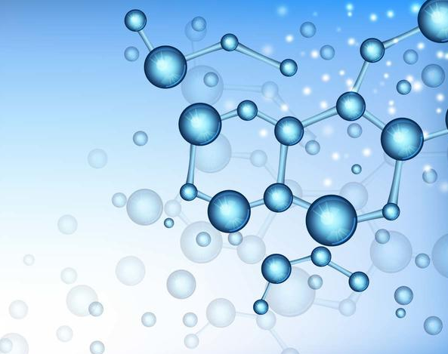
By: Ainhoa Suárez-Llanos Barquilla
NATURAL
SCIENCE

Slide 2
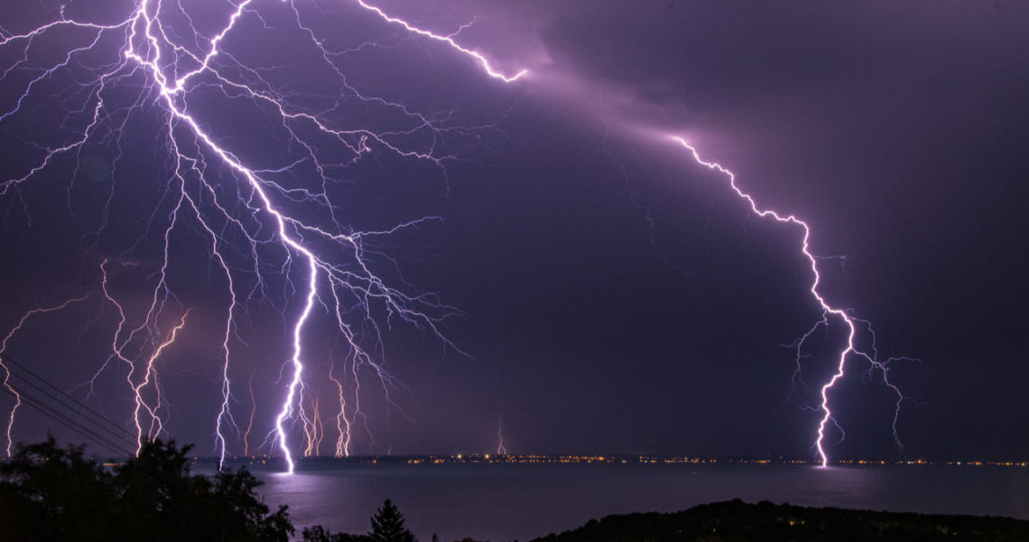
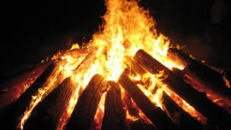
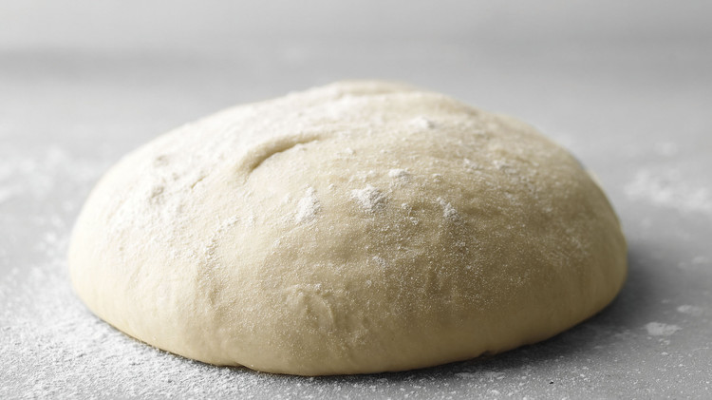
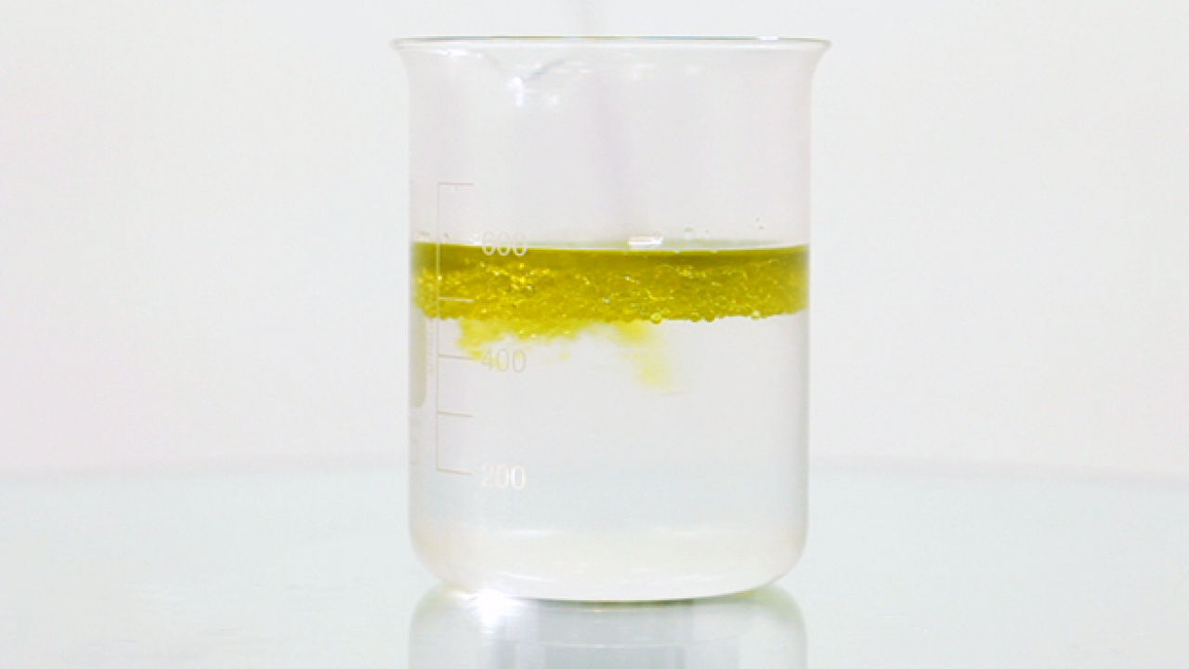
UNIT 3:
MATTER AND ENERGY

Slide 3
Page 77 (Let’s Begin)
1. Look at the photos. What forms of energy can you see? What are they used for?
In the big photo, I can see that there’s electrical, light and heat energy. And in the small photo I can see, that there’s heat and light energy.
2. What forms of water can you see in the photos? What other forms of water can we find in nature?
In the big photo I can see that water is solid and liquid, because some part of the water is frozen. In the small photo, I can see that the water is gas. The forms of water that we can find, are water as liquid, water as solid and water as gas.

Slide 4
3. Discuss these questions:
a)If we heat snow, what happens to it?
It turns into liquid, and if we continue heating it, it turns into gas.
b)What happens when we boil liquids?
The liquids evaporate turning them into gas.
c)What do we get when we burn wood?
We get coal.
d)What other types of fuel do we burn?
We burn fossil fuel, such as coal, wood, natural gas, petrol etc.
e)What is a mixture? Are all mixtures homogeneous?
A mixture is a physical combination of two or more substances. All mixtures aren’t homogeneous, because there are also mixtures called heterogeneous.

Slide 5
4. What types of energy do we use in everyday life? Why are these ypes of energy useful?
We use almost all types of energy everyday, for example, we use electrical energy, we use sound energy, we use light energy, we use heat energy etc. We use these types of energy for many things, such as being able to see in the dark with electric and light energy and so on.
5. What can happen if we don’t save energy? How can we save energy at home and at school? Make five rules for saving energy.
If we don’t save energy, we won’t be able to do many things. Turn off the lights of a room when we get out. The rules are: Turn off the lights of a room when you get out. Don’t leave the refrigerator door open. Use fluorescent blulbs, because they use 75 percent less energy. Take a short shower instead of a long bath. Turn off any device.

Slide 6
Page 80 (Separating mixtures)
1. What is the difference between heterogeneous and homogeneous mixtures?
The difference, is that in heterogeneous mixtures, we can see the substances that the mixture contains, while in the homogeneous we can’t see them.
2. How can we separate these mixtures?
sugar and water: Distillation. petrol and water: Decantation. leaves and water: Filtration. mud and water: Decantation.

Slide 7
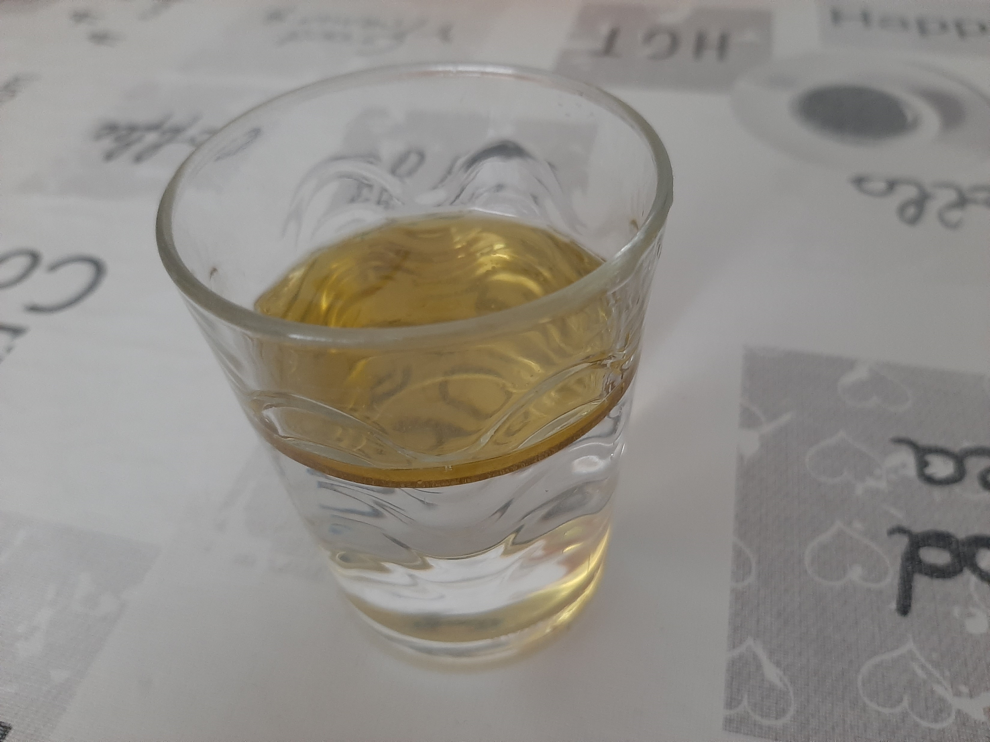
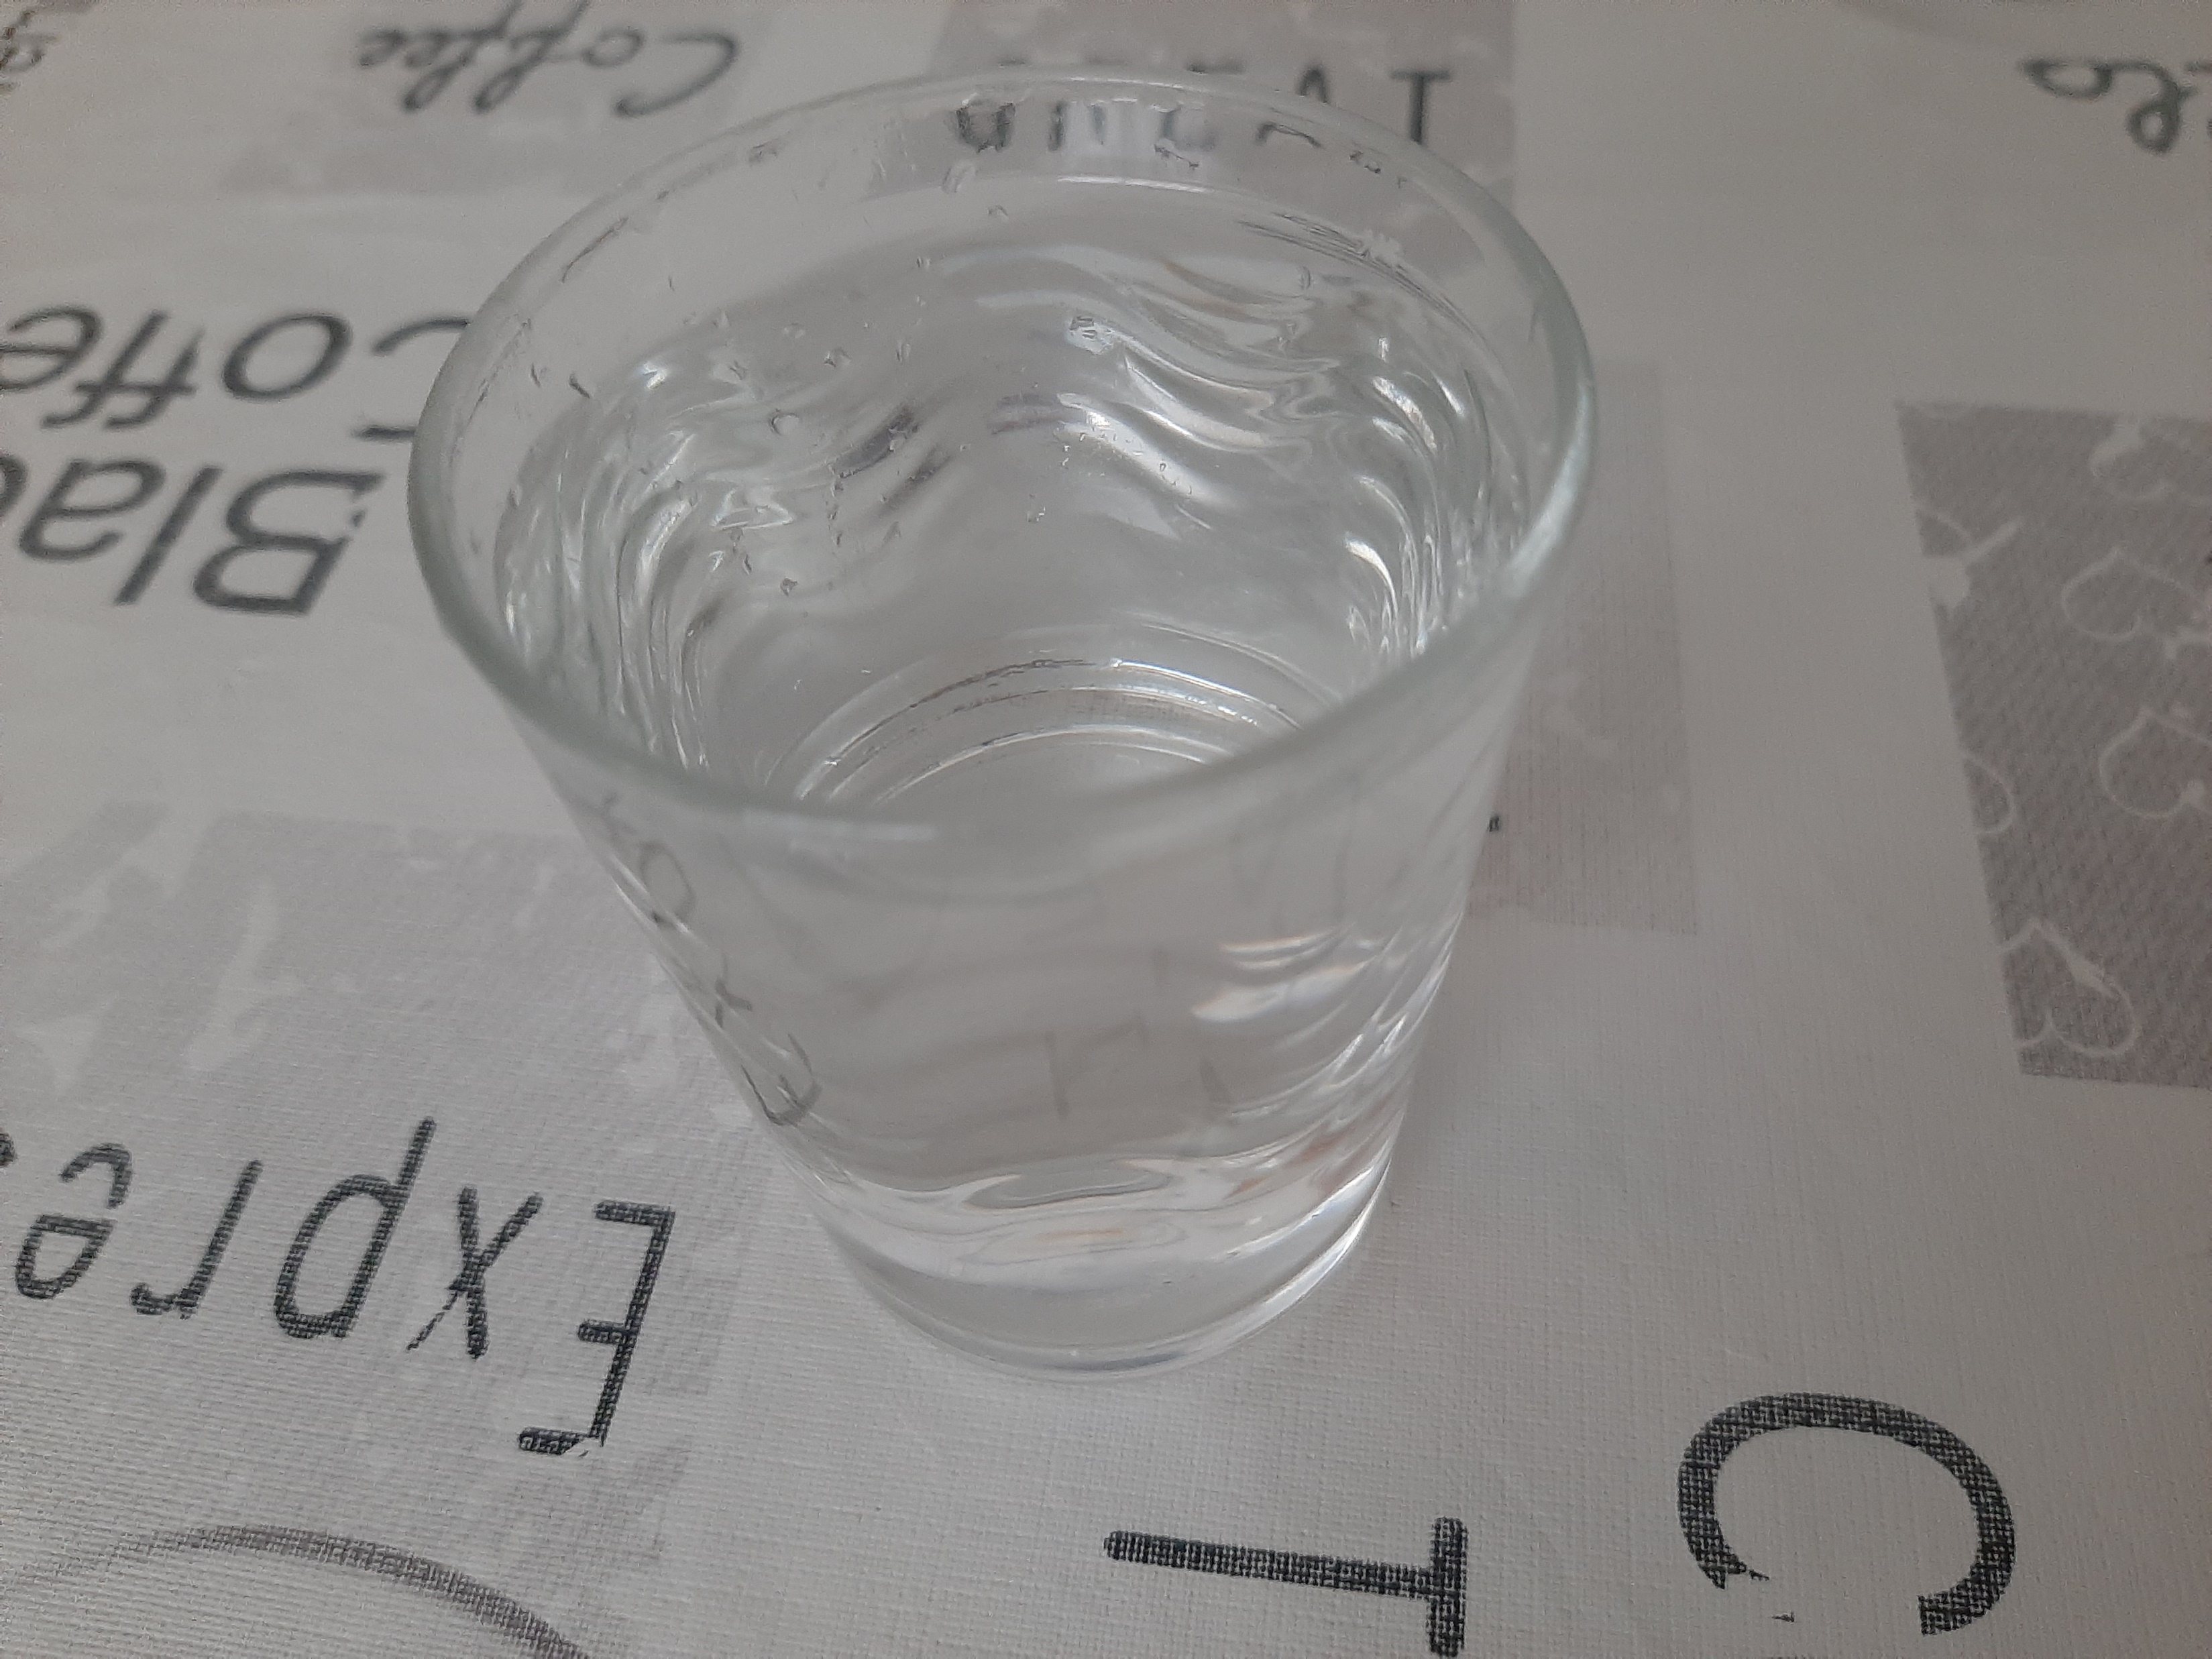
Photos
Homogeneous Mixture
Heterogeneous Mixture
Oil and Water
Salt and water

Slide 8


Test: Mixtures
Result:
9 correct | 0 wrong (100%)
Time:
0:23 seconds

Slide 9
Page 81
3. Discuss the questions with a partner.
a) What can magnets attract? They can attract certain types of metals, such as iron, nickel and cobalt.
b) Why does sand sink in water? It sinks in water, because sand is more dense than water.
c) How does a filter function? A filter stops the particles, but lets gas or liquids pass through.
d) How can we separate oil and water? We need to use decantation. As oil has a lower density and it floats on water, we can decant it to another container.

