Slide 1
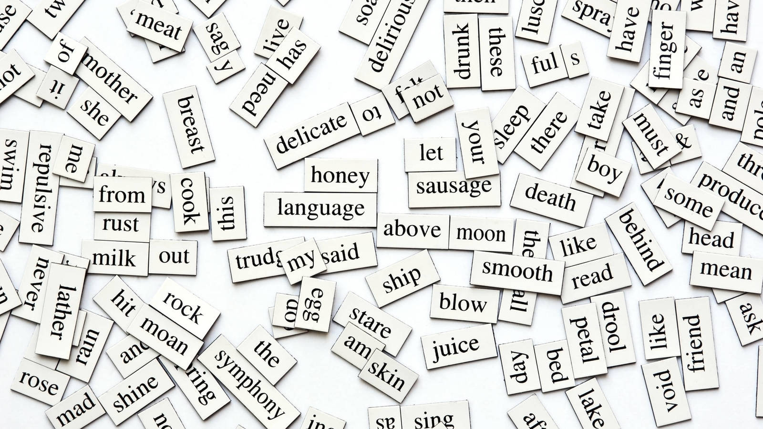
ENGLISH
By: Ainhoa Suárez-Llanos Barquilla

Slide 2
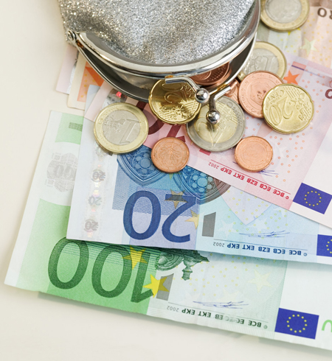
UNIT 7:
Buying and selling

Slide 3
Page 72 (Unit 7 Buying and selling)
1. Look at Kelvin’s photos. Answer the questions.
1)What can you see in the photos? I can see many things related to money, such as coins, price tags etc.
2)Where do you and your family go shopping? We go shopping to the supermarkets next to out house, usually, we go to the Carrefour and the Mercadona. To buy clothes we go to many malls, such as La Gavia and Parque Corredor.
3)Do you or your family buy things online? Do you prefer shopping online or in a shop? Of course my family buys things online. I really like buying things only, because you don’t need to go to the store, but if it something of clothes, I prefer going to the store, because you can see which clothes fit and which ones not.

Slide 4
2. Look and match with potos 1-12. Listen, check and repeat.
Purse
Credit card
Coins
Banknotes
Price tag
Receipt
Customer
Cashier
Till
Spend money
Save money
Money box

Slide 5
Page 73
5. Read the rest of Kelvin’s message. Would you like to take part in a sale like this? What would you sell?
I don’t really like sales, because everybody joins and it’s claustrophobic, but I think I would, to get some money. I would sell the clothes I don’t wear anymore, and some books I already read, or that I don’t enjoy.

Slide 6
Page 74
1. Describe the photo. Why do you think Kelvin has included it? Read and listen to find out.
I think he included it, because he says that he is going to sell his teddy bears, and he’s showing it to Jess.
2. Read an say true or false. Correct the false sentences.
1)The prices at the sale are higher than in the shops. False. The prices at the sale are lower than in the shops. 2)They aren’t going to have the sale in the school hall because it’s too small. True. 3)The teddies are for children younger than kevin. True. 4)Kevin wants the sale to be as fair as possible. True.

Slide 7
6. Look at the pictures and make sentences.
1: The red t-shirt is more expensive than the blue one.
2: The plant is bigger than the bag.
3: The shelf is taller than the girl.
4: The girl is older tan the boy.

